Slide 1
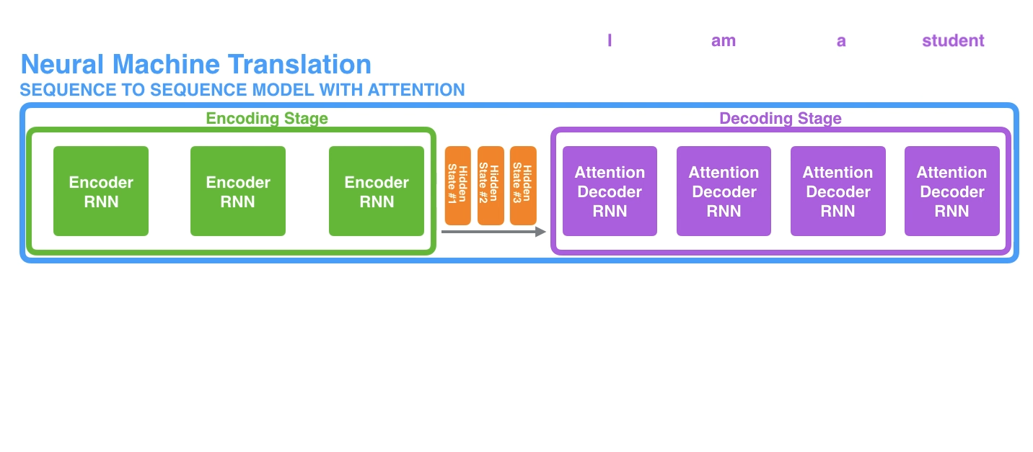
Recap: Sequence to sequence w/ attention

Slide 2
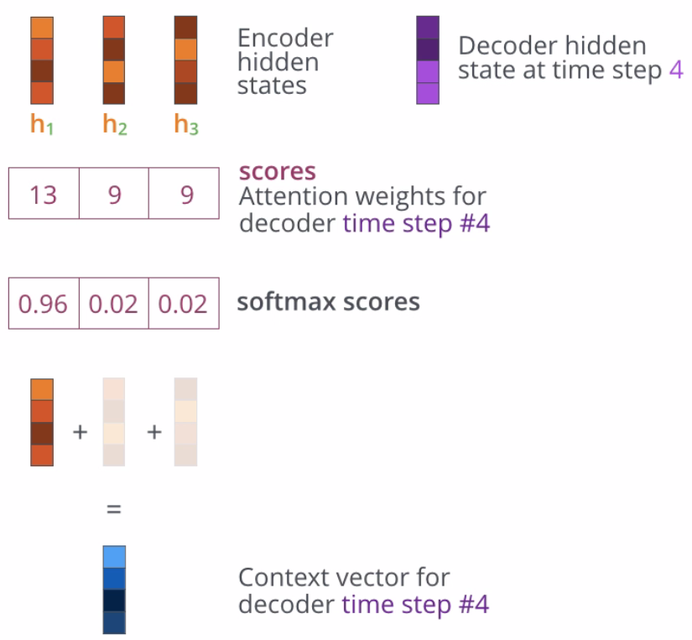
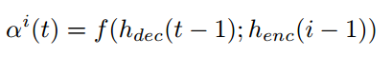
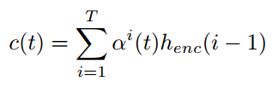
Score
Query (Q)
Key (K)
Value (V)

Slide 3
What functions can be used to calculate the score?
Additive attention
Computes the compatibility function using a feed-forward network with a single hidden layer
Dot-product (multiplicative) attention
Dot-product attention is much faster and more space-efficient in practice, since it can be implemented using highly optimized matrix multiplication code (used in transformer, explained here)

Slide 4
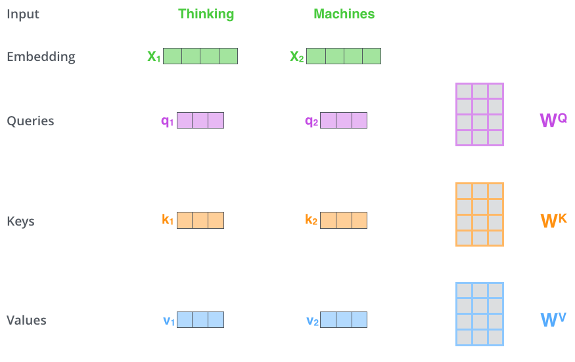
Dot-product (multiplicative) attention

Slide 5
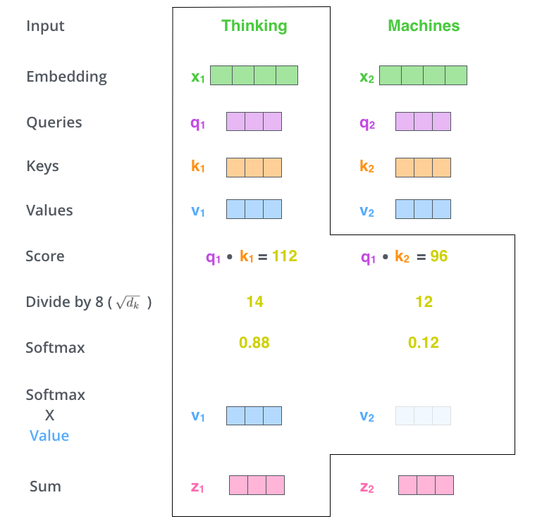
Dot-product (multiplicative) attention

Slide 6
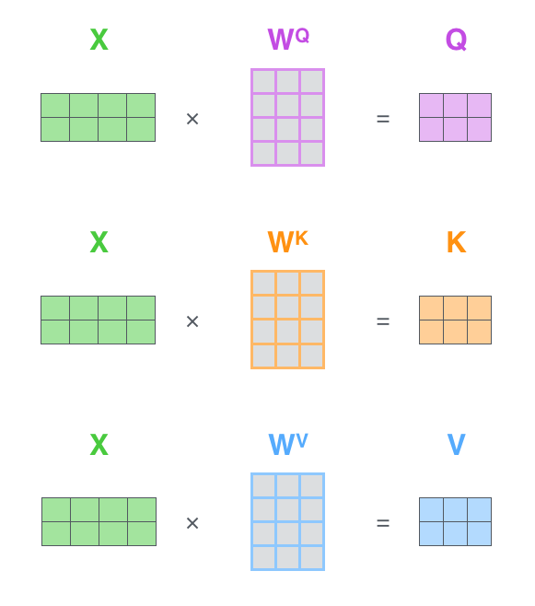
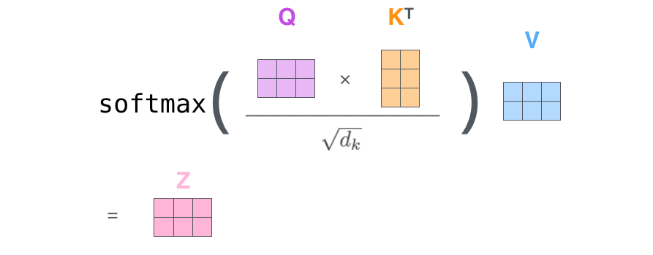
Dot-product (multiplicative) attention

Slide 7
Why divide by square root of d_{k} ?

Slide 8
Scaling Factor
Problem: Additive attention outperforms dot product attention without scaling for larger values of d_{k}.
Cause: Dot products grow large in magnitude, pushing the softmax function into regions where it has extremely small gradients.
Solution: To counteract this effect, scale the dot products by 1/√d_{k}

Slide 9
This is the encoder-decoder attention.

Slide 10
Attention
Attention between encoder and decoder is crucial in NMT
Why not use (self-)attention for the representations?

Slide 11
Attention-only Translation Models
Problems with recurrent networks:
Sequential training and inference: time grows in proportion to sentence length. Hard to parallelize.
Long-range dependencies have to be remembered across many single time steps.
Tricky to learn hierarchical structures (“car”, “blue car”, “into the blue car”…)
Alternative:
Convolution – but has other limitations.

Slide 12
Self-Attention
Information flows from within the same subnetwork (either encoder or decoder). Convolution applies fixed transform weights. Self-attention applies variable weights (but typically not transformations):
image from Lukas Kaiser, Stanford NLP seminar

Slide 13
Self-Attention “Transformers” (not spatial transformers)
Constant path length between any two positions.
Variable receptive field (or the whole input sequence).
Supports hierarchical information flow by stacking self-attention layers.
Trivial to parallelize.
Attention weighting controls information propagation.
Can replace word-based recurrence entirely.
Vaswani et al. “Attention is all you need”, arXiv 2017

Slide 14
Attention in Transformer Networks
We saw this in Bahdanau and Luong models
image from Lukas Kaiser, Stanford NLP seminar

Slide 15
Attention in Transformer Networks
Replaces word recurrence in encoder and decoder
image from Lukas Kaiser, Stanford NLP seminar

Slide 16
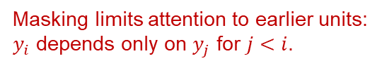
Attention in Transformer Networks
Masking limits attention to earlier units:
$y_{i}$ depends only on $y_{j}$ for $j<i$.
image from Lukas Kaiser, Stanford NLP seminar

Slide 17
The Transformer
Basic unit shown at right.
In experiments, stacked with N=6.
Output words fed back as input, shifted right. Can use beam search as before.
Inputs and outputs are embedded in vector spaces of fixed dimension.
Positional encoding: when words are combined through attention, their location is lost. Positional encoding adds it back.

Slide 18
Attention Implementation
Attention is modeled as a key-value store: Q = query vector K = key V = value
Encoder-decoder layer: the queries come from the previous decoder layer, and the memory keys and values come from the output of the encoder. (Similar to Bahdanau).
Self-attention layer: all of the keys, values and queries come from the output of the previous layer in the encoder.

Slide 19
Multi-Headed Attention
Simple attention blends the results of all the attended-to inputs. It doesn’t allow a per-input transformation, as convolution does.
The solution is to use “multi-headed attention”:

Slide 20
Multi-Headed Attention

Slide 21
Multi-Headed Attention
Anaphora (pronoun or article) resolution

Slide 22
Multi-Headed Attention
Anaphora (pronoun or article) resolution

Slide 23
Transformer Results
Notes:
Mention that transformers train very well in practice. Perhaps an order of magnitude faster compared to other methods for similar accuracy.

Slide 24
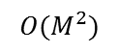
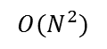

English-to-English Translation ?!
Yes, it does make sense. a.k.a. summarization.
Liu et al, “GENERATING WIKIPEDIA BY SUMMARIZING LONG SEQUENCES” arXiv 2018
M = input length, N = output length
Summarization: M >> N
$$O(MN)$$
$$O(M^{2})$$
$$O(N^{2})$$

Slide 25
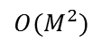
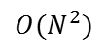
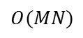
Large-scale Summarization (Wikipedia)
Like translation, but we completely remove the encoder.
Source data (large!):
The references for a Wikipedia article.
Web search using article section titles, ~ 10 web pages per query.
$$O(MN)$$
$$O(M^{2})$$
$$O(N^{2})$$

Slide 26
Large-scale Summarization
Results:
L = input window length.
ED = encoder-decoder.
D = decoder only.
DMCA = a memory compression technique (strided convolution).
MoE = mixture of experts layer.
Liu et al, “GENERATING WIKIPEDIA BY SUMMARIZING LONG SEQUENCES” arXiv 2018

Slide 27

Translation Takeaways
Sequence-to-sequence translation
- Input reversal - Narrow beam search
Adding Attention
- Compare latent states of encoder/decoder (Bahdanau). - Simplify and avoid more recurrence (Luong).

Slide 28
Translation Takeaways
Parsing as translation:
- Translation models can solve many “transduction” tasks.
Attention only models:
- Self-attention replaces recurrence, improves performance.
- Use depth to model hierarchical structure.
- Multi-headed attention allows interpretation of inputs.

